Slide 1
Sensation and Perception
Chapter 5

Slide 2
Agenda
Sensation vs. Perception
Vision
Hearing
Additional Senses
Gestalt Psychology

Slide 3
Reminders
Earn Exam Credit back
Only available for Exam 1
Earn 25% of points missed back
Must be completed before next exam, so you must have the meeting scheduled by 2/23
Research Points
Deadline for Research Points Part 1: March 5th
Dr. Scheuler presents at Sigma Xi on 2/23
Multiple SONA studies are up
It’s a good idea to stock up on points now, since it will be harder to get points for Research Points Part 2, due to SONA studies closing

Slide 4
We actually have MORE than the 5 main senses!
Vision, hearing, smell, taste, and touch PLUS
Balance (the vestibular sense)
Body position and movement (proprioception and kinesthesia)
Pain (nociception)
Temperature (thermoception)

Slide 5
Have you been reading your textbook?
What’s the difference between sensation and perception?
What is transduction and why is it important?
What’s the difference between the absolute threshold and the difference threshold?
Can you name an example of a subliminal message?

Slide 6
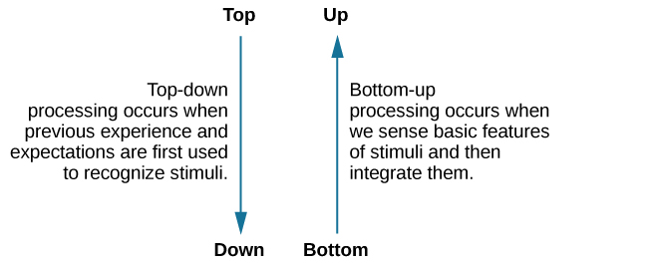
Processing
Note: These processes often work in tandem

Slide 7

Bottom-Up Processing

Slide 8

Top-Down Processing
Who is this?

Slide 9
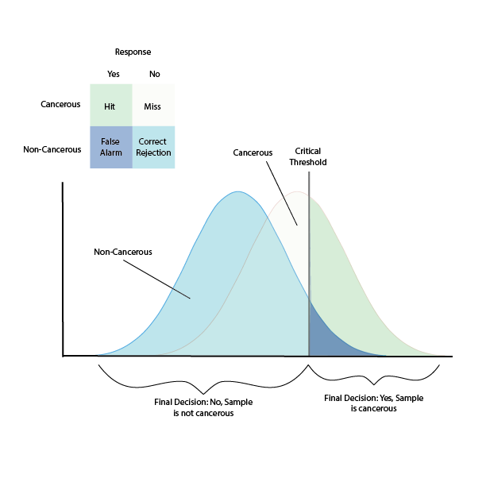
Are you paying attention?
Sensory adaption- our ability to ignore stimuli after it has been a constant around us for an extended period of time
Ex: cat litter box
Inattentional blindness- the failure to notice something that is completely visible because the person was actively attending to something else and did not pay attention to other things
Ex: video games and an annoyed mother
Signal detection theory- the ability to identify a stimulus when it is embedded in the background
Ex: detecting if tissue is cancerous

Slide 10
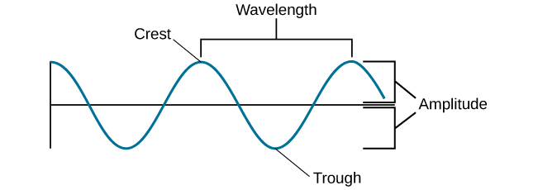
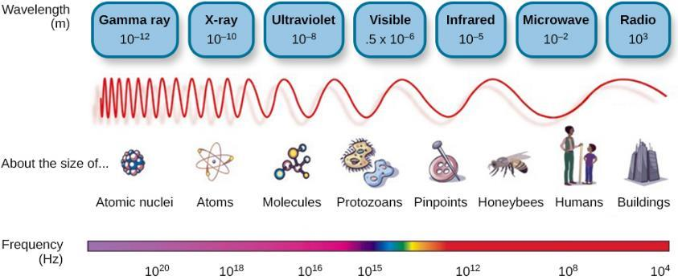
Waves
Wavelength – distance between peaks
Amplitude – distance between the center line to a peak; impacts loudness
Frequency – number of waves within a given period of time; impacts pitch

Slide 11
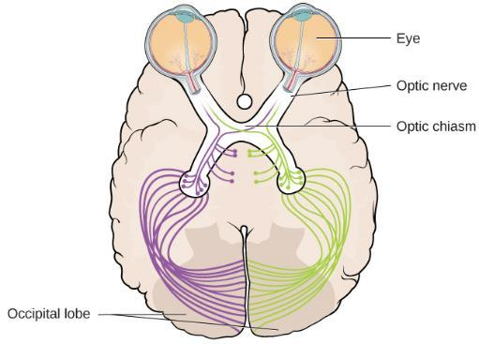
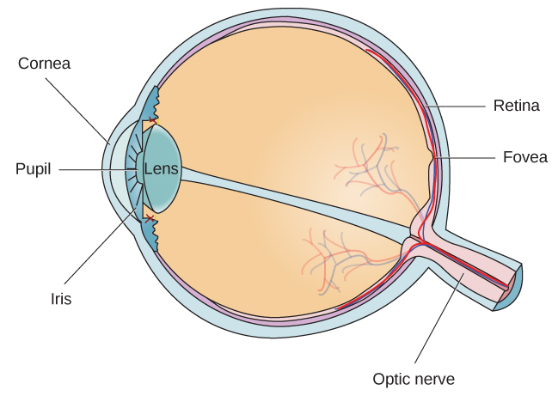
Anatomy of the Eye

Slide 12
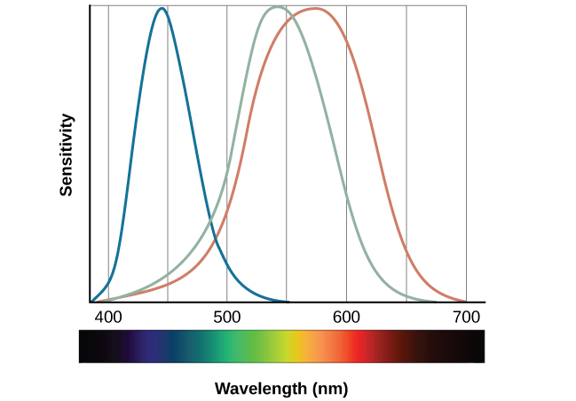
Color Vision
Trichromatic Theory
Opponent-Process Theory
All colors in the spectrum can be produced by combining red, green, and blue.
Color is coded in opponent pairs: black-white, yellow-blue, and green-red.
Cells excited by green wavelengths would be inhibited by red
Leads to afterimages

Slide 13

Depth Perception
Binocular cues vs. monocular cues
Linear perspective

Slide 14
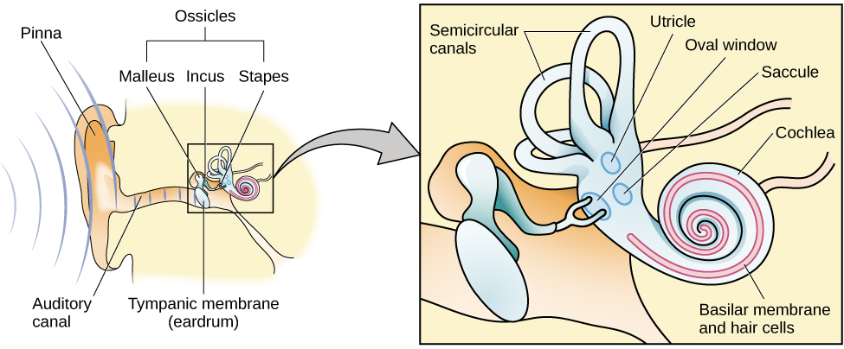
Anatomy of the Ear

Slide 15
Pitch Perception
Temporal Theory
Place Theory
Frequency is coded by the activity level of a sensory neuron
A given hair cell would fire action potentials related to the frequency of the sound wave.
Different portions of the basilar membrane are sensitive to sounds of different frequencies
Location of hair determines frequency processed

Slide 16
Sound Localization
We’ve learned about monocular and binocular… So, what about monaural and binaural?
How do the interaural level difference and interaural timing difference contribute to binaural cues?

Slide 17
Hearing Loss
Congenital deafness
Conductive hearing loss
Sensorineural hearing loss
Ménière's disease
Symptoms can include tinnitus, vertigo, and inner ear pressure

Slide 18
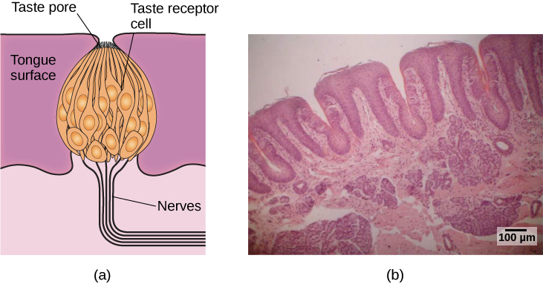
Taste
Sweet
Salty
Sour
Bitter
Umami
Fatty

Slide 19
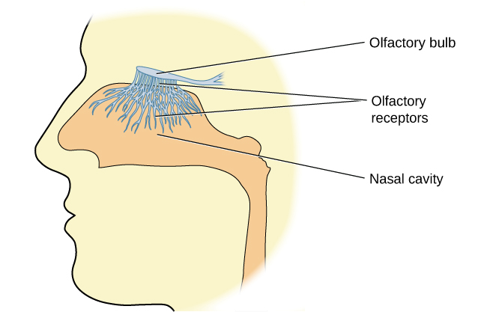
Smell

Slide 20
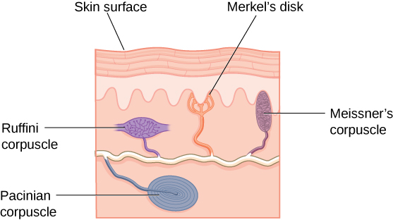
Touch, Thermoception, and Nociception

Slide 21
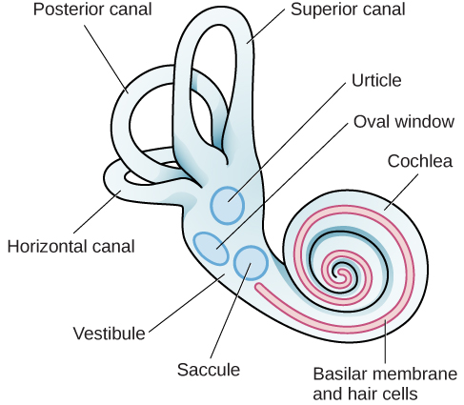
The Vestibular Sense, Proprioception, and Kinesthesia

Slide 22
What is Gestalt psychology?

Slide 23

Figure-Ground Relationship

Slide 24
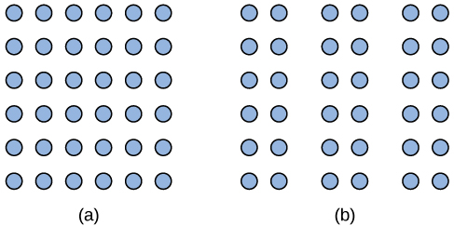
The Principle of Proximity

Slide 25
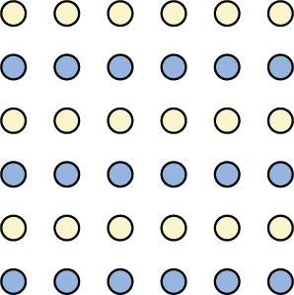
The Principle of Similarity

Slide 26

The Principle of Continuity

Slide 27

The Principle of Closure

Slide 28
Next Time on PSY 203…
Before Next Class:
Next Class:
Read Chapter 6
Take Chapter 6 Quiz
Due by Thursday’s class
Submit Exam Reflection
Due tonight at 11:59 pm
Potentially: Email Dr. S to make up exam points
Chapter 6 – Learning (Day 1)

